Slide 1
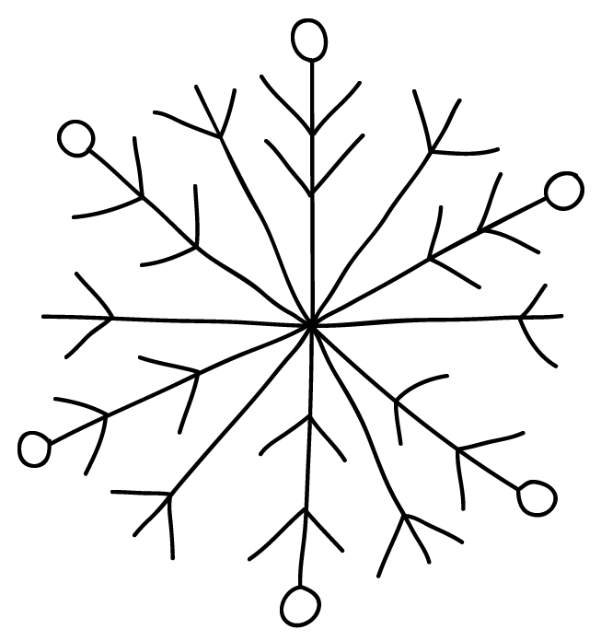
Winter Break Challenge
Sunday | Monday | Tuesday | Wednesday | Thursday | Friday | Saturday
10 | 11 | 12 | 13 | 14 | 15 | 16
17 | 18 | 19 | 20 | 21 | 22 | 23
24 | 25 | 26 | 27 | 28 | 29 | 30
31 | 01 | 02 Finish a book. | 03 | 04 | 05 | 06
Read the last page or chapter of a book
Read in your PJs!
Read to a family member.
Write a letter to your favorite author.
Write an
email/letter to your teacher about your break.
Solve
4187/6
Read a recipe card.
Read
with a flashlight.
Read on
the floor.
Write 2 thank you notes!
Set 2
goals for 2018!
Read for exactly 21 minutes.
Read aloud in a silly voice.
As you finish each challenge, place a check in the box and color a snowball!
Is it okay if you skip a day or flip-flop challenges? Absolutely!
At the end of the break, have an adult sign here to give your hard work
the ‘okay’!

Slide 2
Families,
Happy Winter Break! I am so excited to introduce you and your student to our Winter Break Challenge. This challenge is not meant to be daunting, serious, or involve a lot of rules. Rather, the goal is to keep students reading and writing in FUN ways. From reading in your PJs to sending an email to me, I have included many opportunities for your family to ‘sneak’ in some literacy moments.
As your student completes each challenge, have him or her place a check in the box and color a snowball! Is it okay if your students decides to skip a day or flip-flop challenges? Absolutely! At the end of the break, please sign the bottom of your student’s Challenge Calendar and return it to school. We will celebrate those who accepted the winter challenge the first week back!
I hope you and your family find these activities simple and fun moments in your Winter Break. Best wishes for a wonderful few weeks; I look forward to seeing your student soon!
Happy Winter Break,

Slide 3
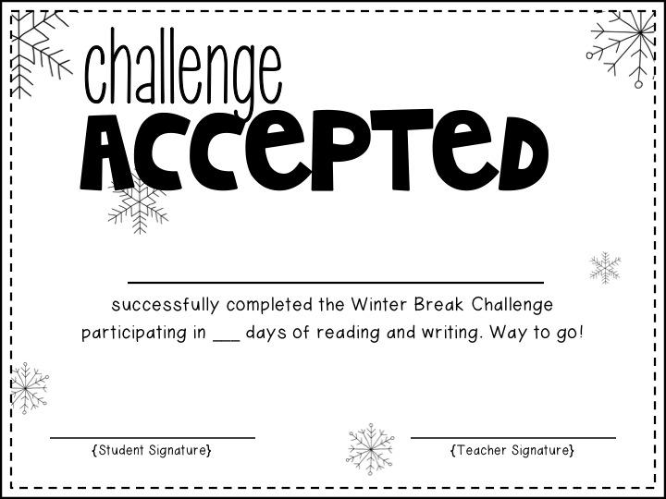
Student’s Name

Slide 4
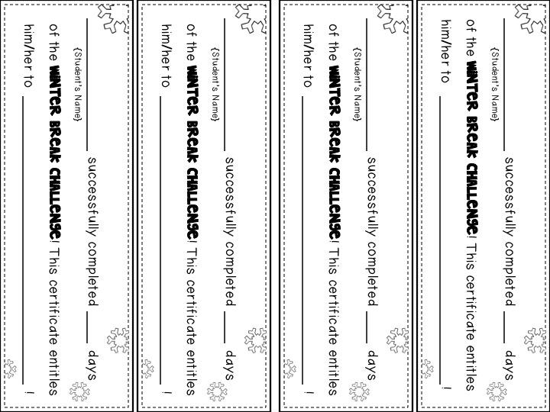
Student’s Name
Student’s Name
Student’s Name
Student’s Name
Reward/Celebration
Reward/Celebration
Reward/Celebration
Reward/Celebration
#
#
#
#

Slide 5
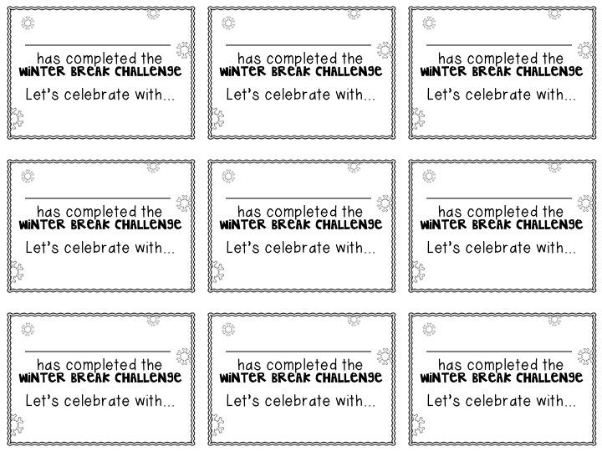
Student’s Name
Student’s Name
Student’s Name
Student’s Name
Student’s Name
Student’s Name
Student’s Name
Student’s Name
Student’s Name

